Slide 1
AP Statistics
Chapter 4 Review

Slide 2
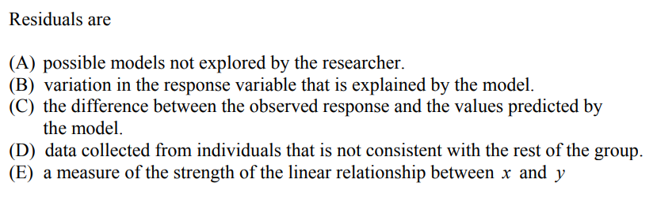

Slide 3
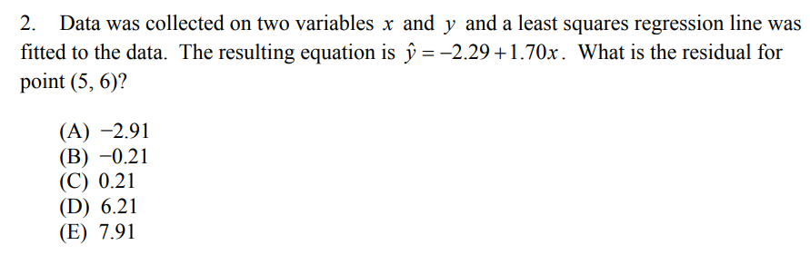

Slide 4
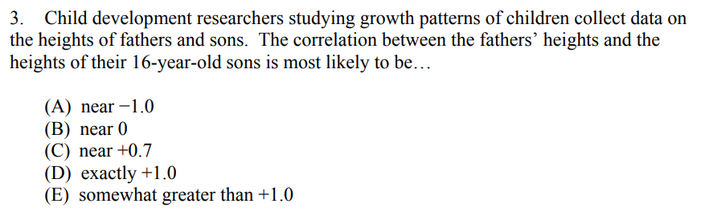

Slide 5
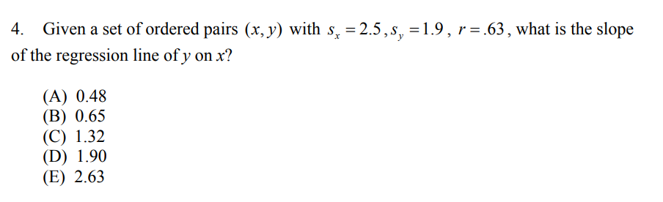

Slide 6
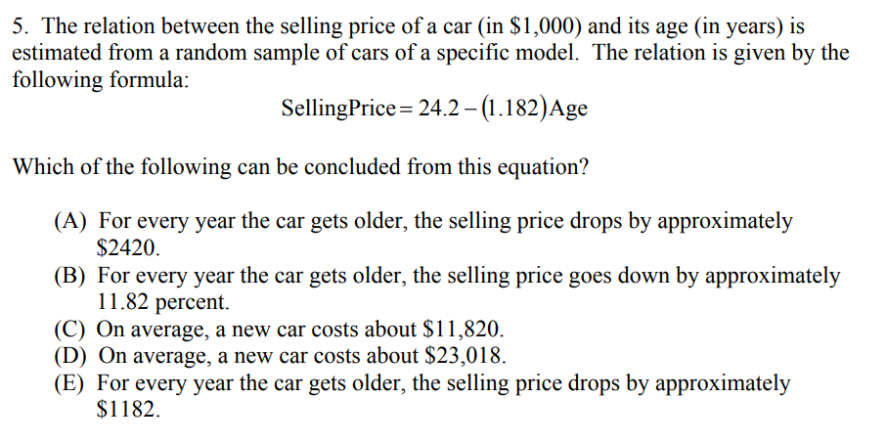

Slide 7
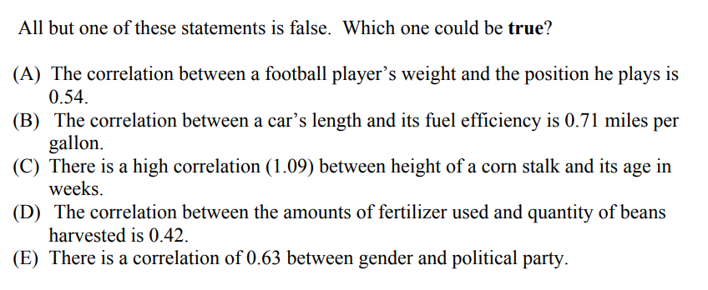

Slide 8
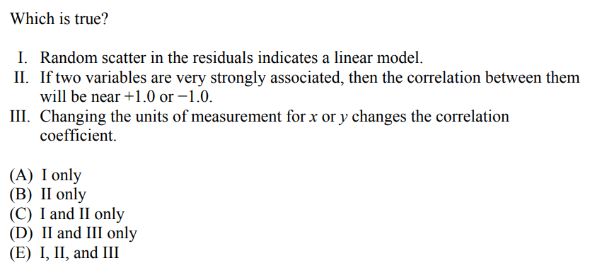

Slide 9
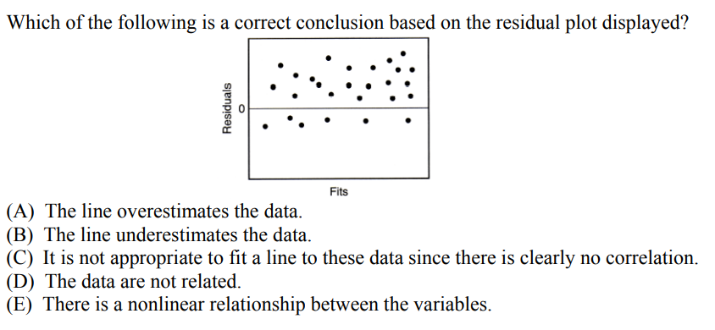

Slide 10
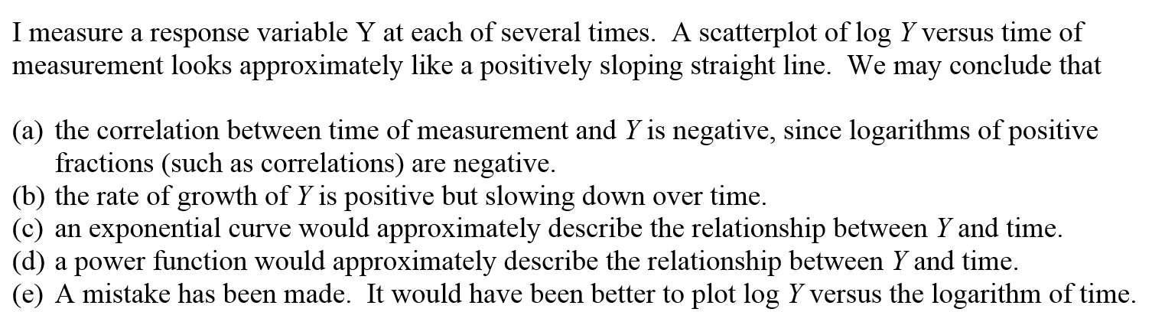
Answer: “C”
If log Y and time forms a linear relationship, then

Slide 11
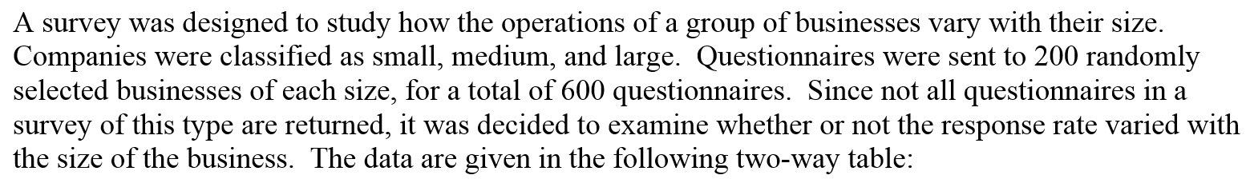
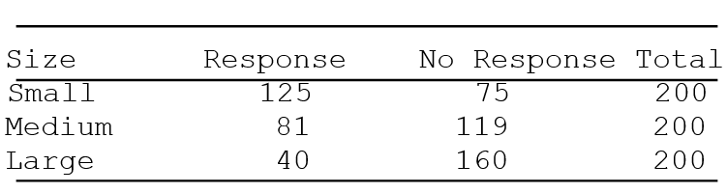
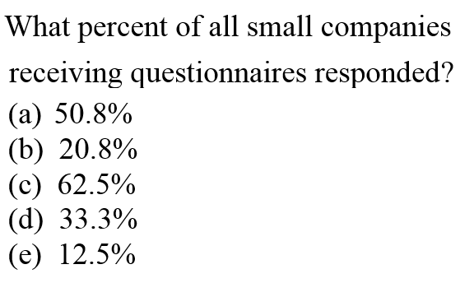
In total, 200 small companies responded. Out of 200, 125 responded
Percentage = 125/200
=5/8
=0.625
Answer “C”

Slide 12
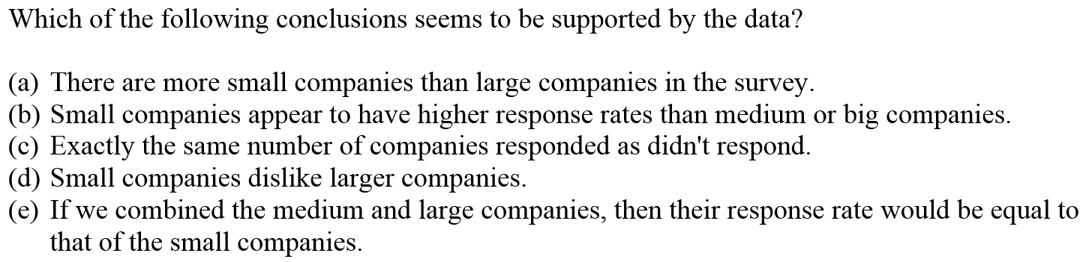
Answer: “B”

Slide 13
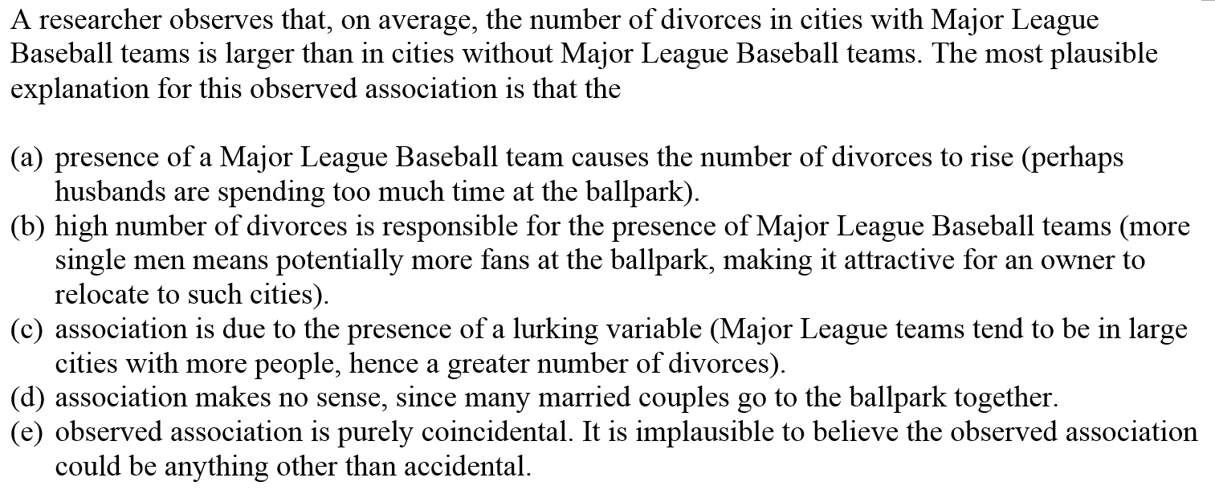
Answer: “C”, lurking variable is city population. A larger city population would likely increase the chances of both variables: having a Major League baseball team and number of divorcees

Slide 14
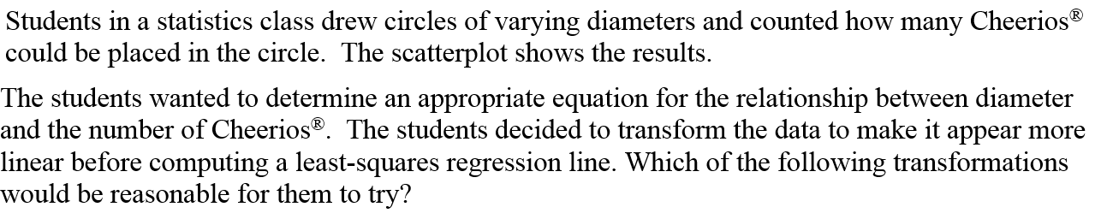
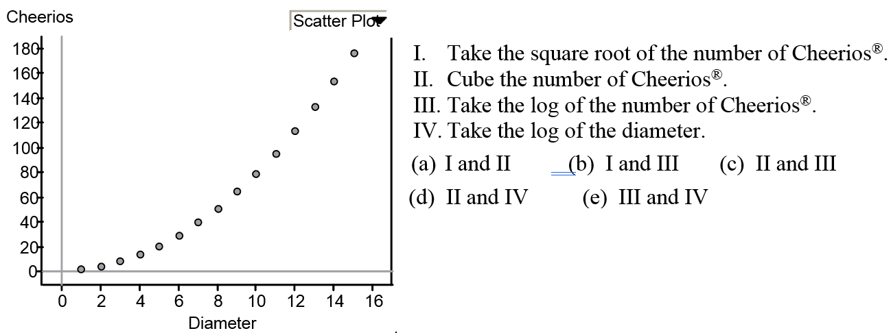
Answer “B”.
I) “Square root” works b/c the equation of a circle is A=πr².
iii) Taking the log of “y” would be reasonable to try, but to get a linear eq, b/c the exponent of “r” would be moved to the front of “r’.

Slide 15
Answer “A”, Slope is change in “Y’ over change in “x’.

Slide 16
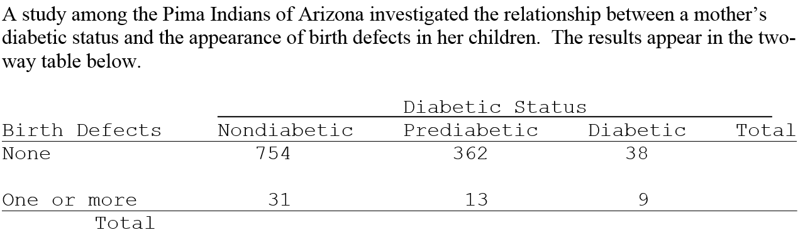
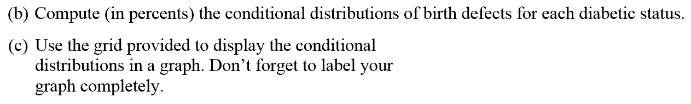

Slide 17

b) What is the marginal distribution of for each Diabetic status?
Non Diabetic:
Pre Diabetic:
Diabetic:
None: One or mOre
None: One or mOre
None: One or mOre
754/785
31/785
362/375
13/375
38/47
9/47
3.5%
81%
19%
96%
4%
96.5%

Slide 18
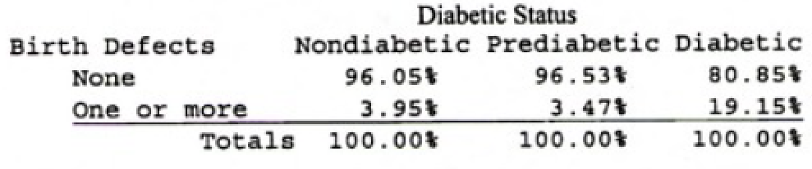
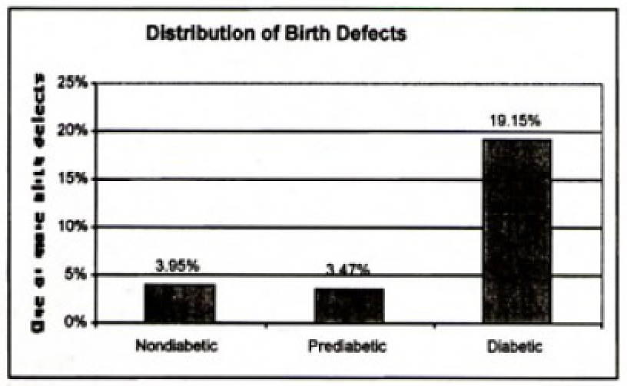

Slide 19
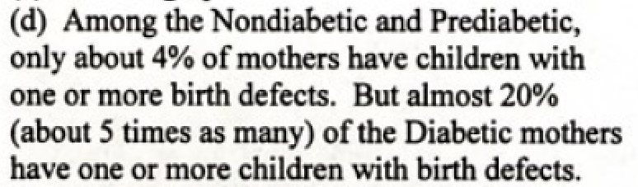

Slide 20
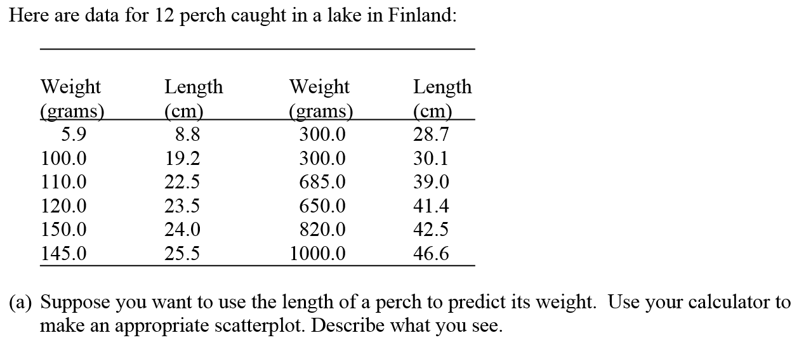
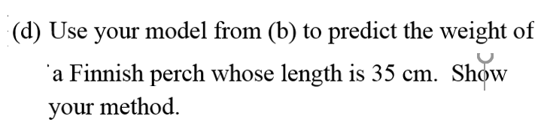
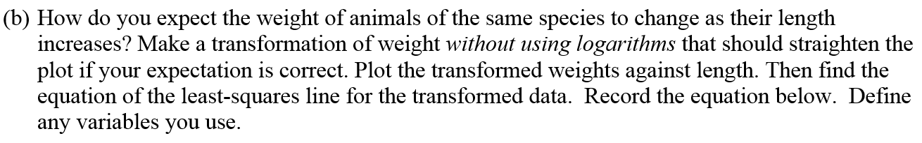

Slide 21
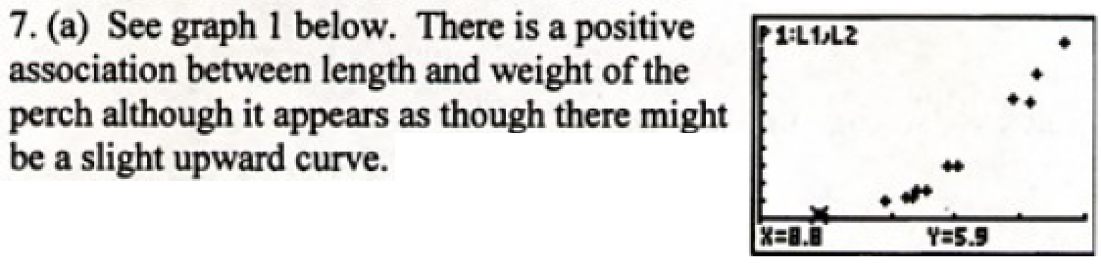

Slide 22
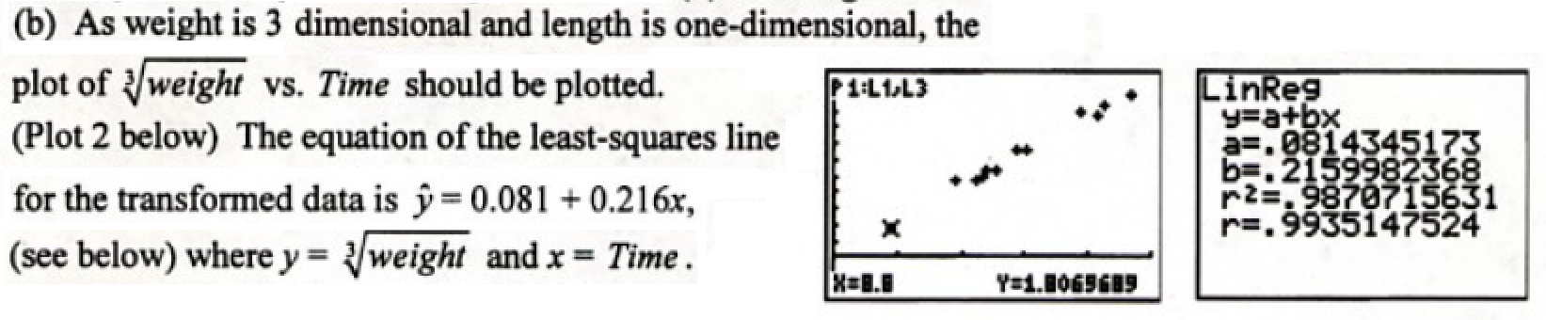

Slide 23
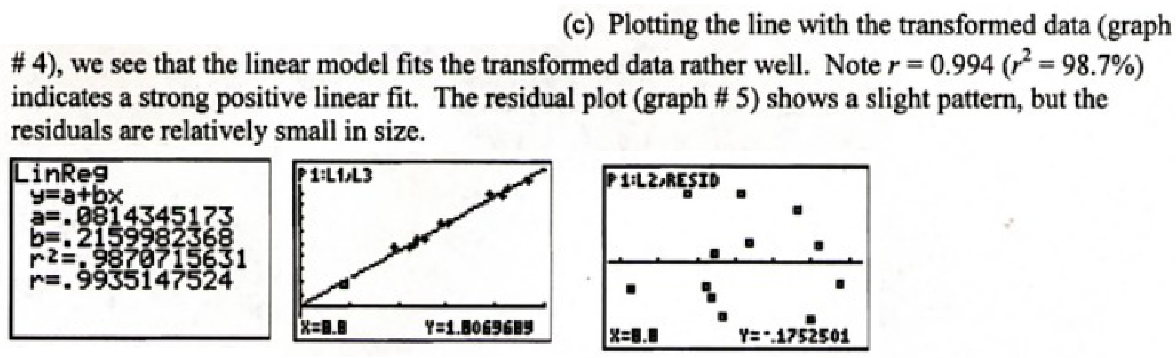

Slide 24
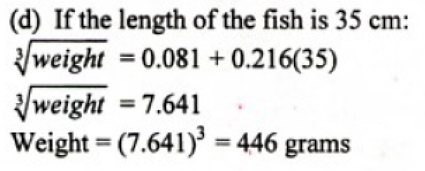

Slide 25
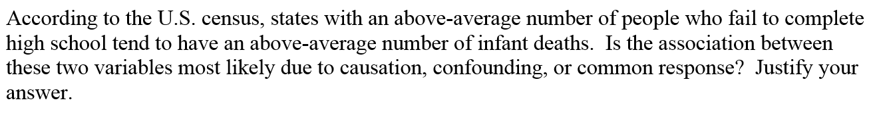

Slide 26
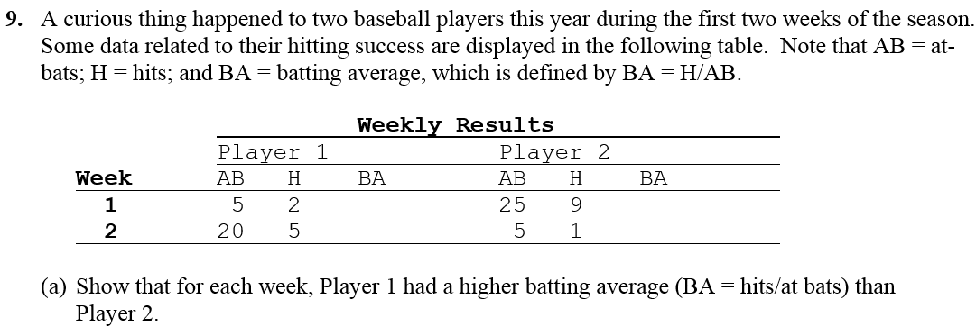

Slide 27
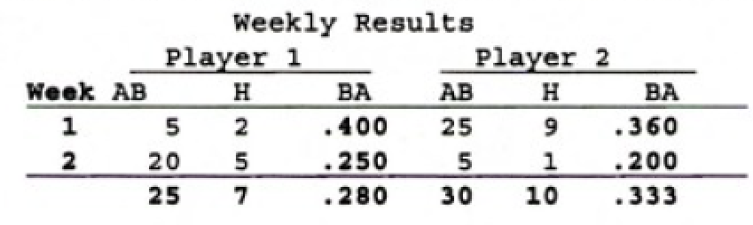
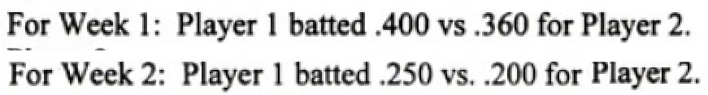

Slide 28
